Slide 1
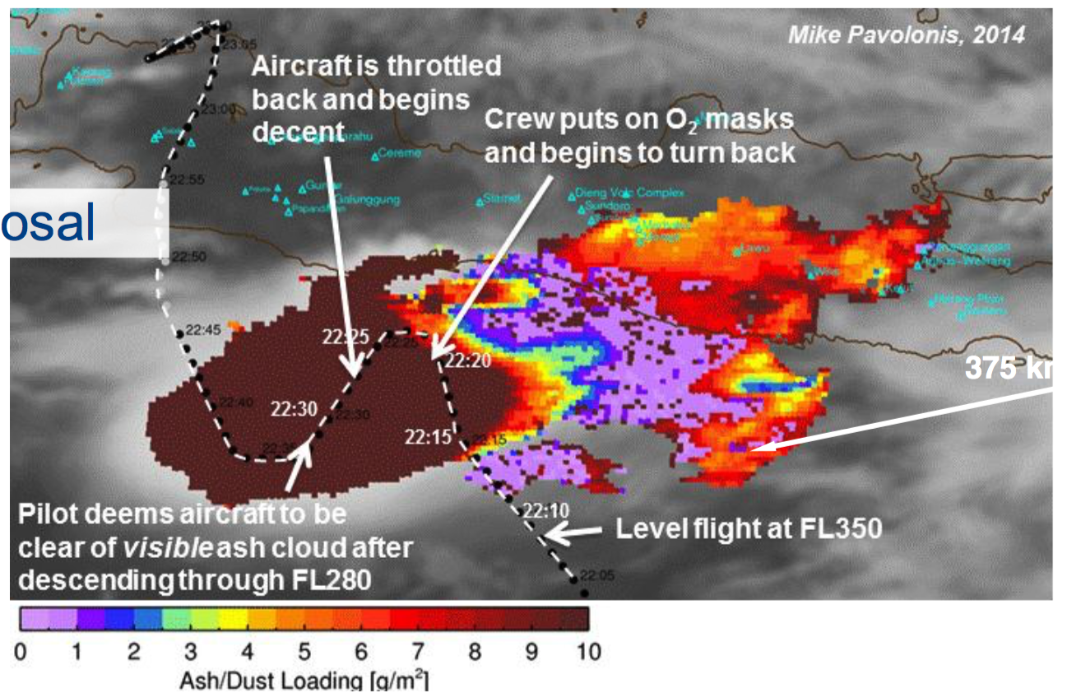
Detection of distil volcanic ash cloud project intro

Slide 2
Detection of distil volcanic ash cloud project intro

Slide 3
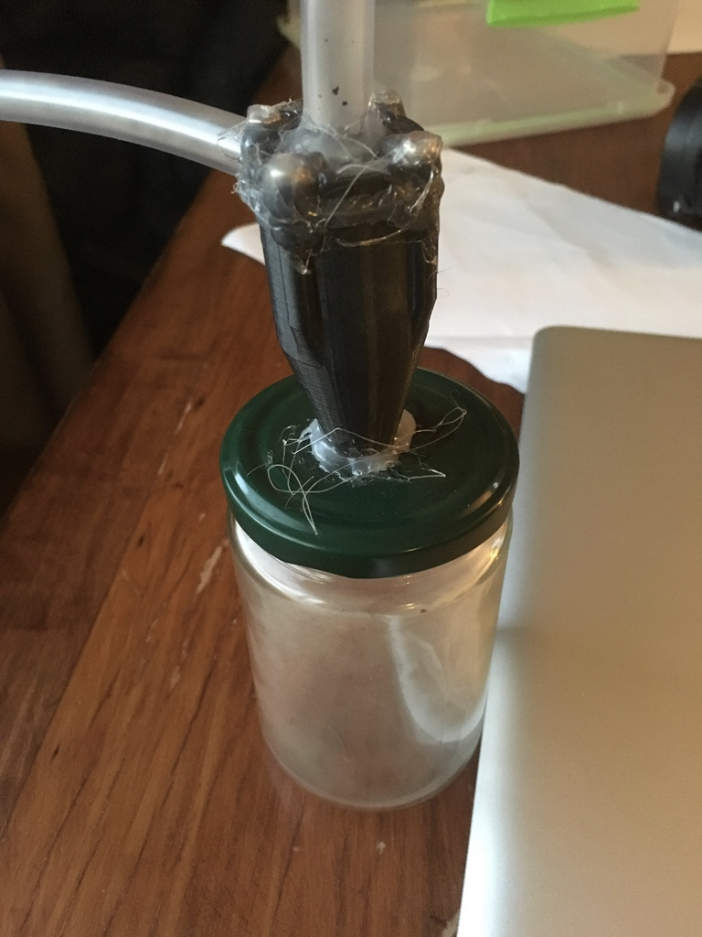
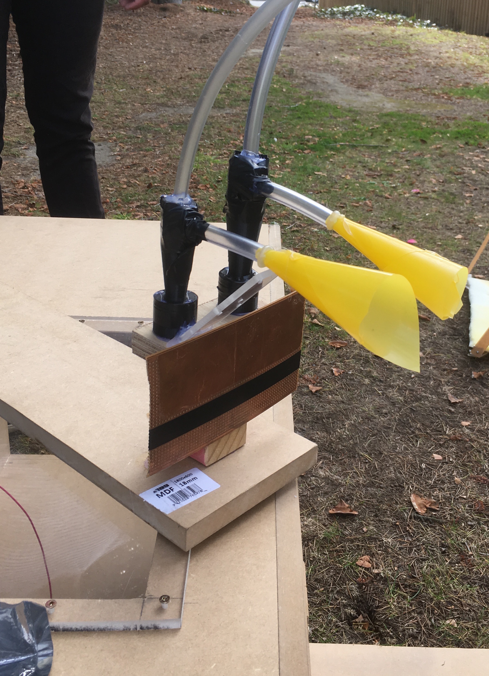
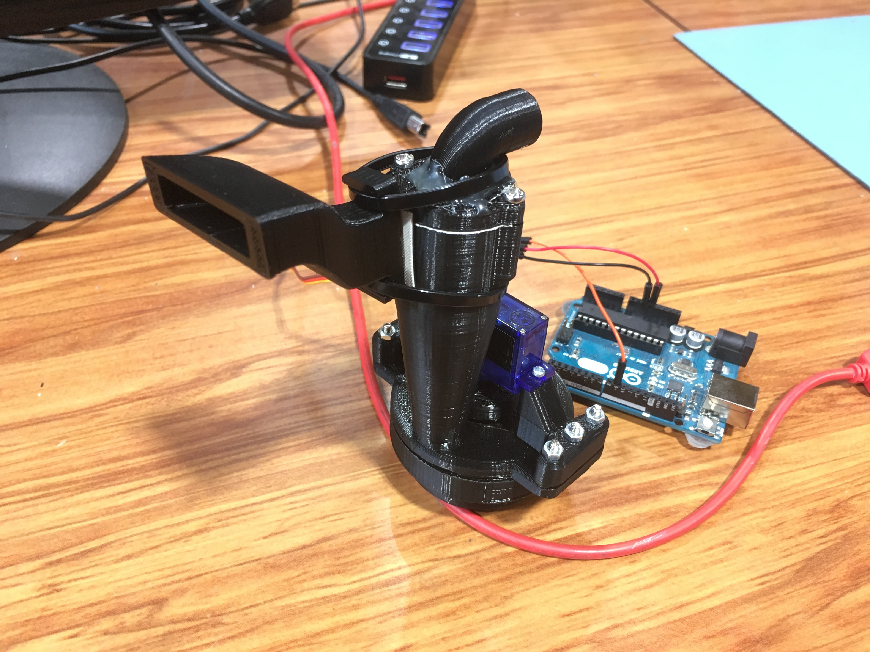
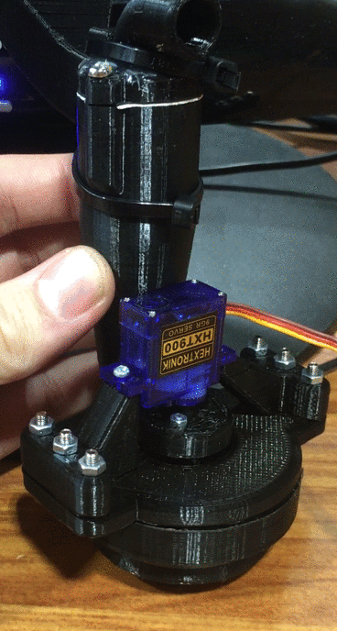
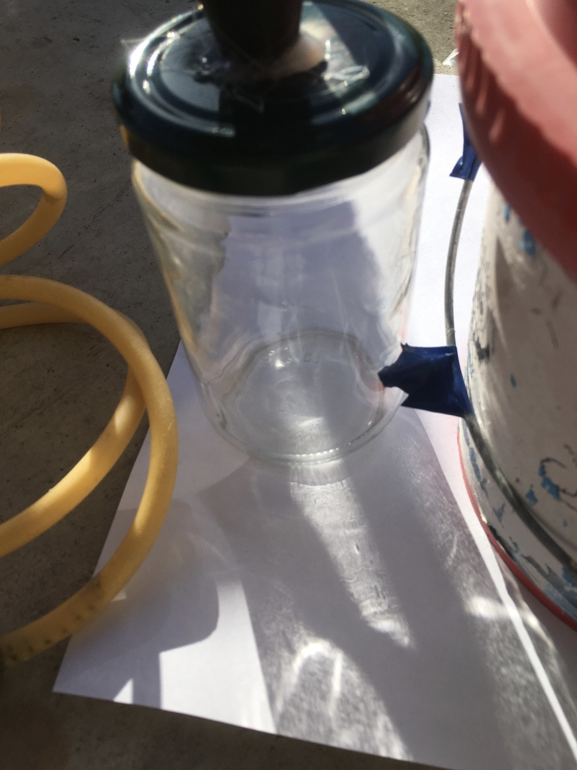
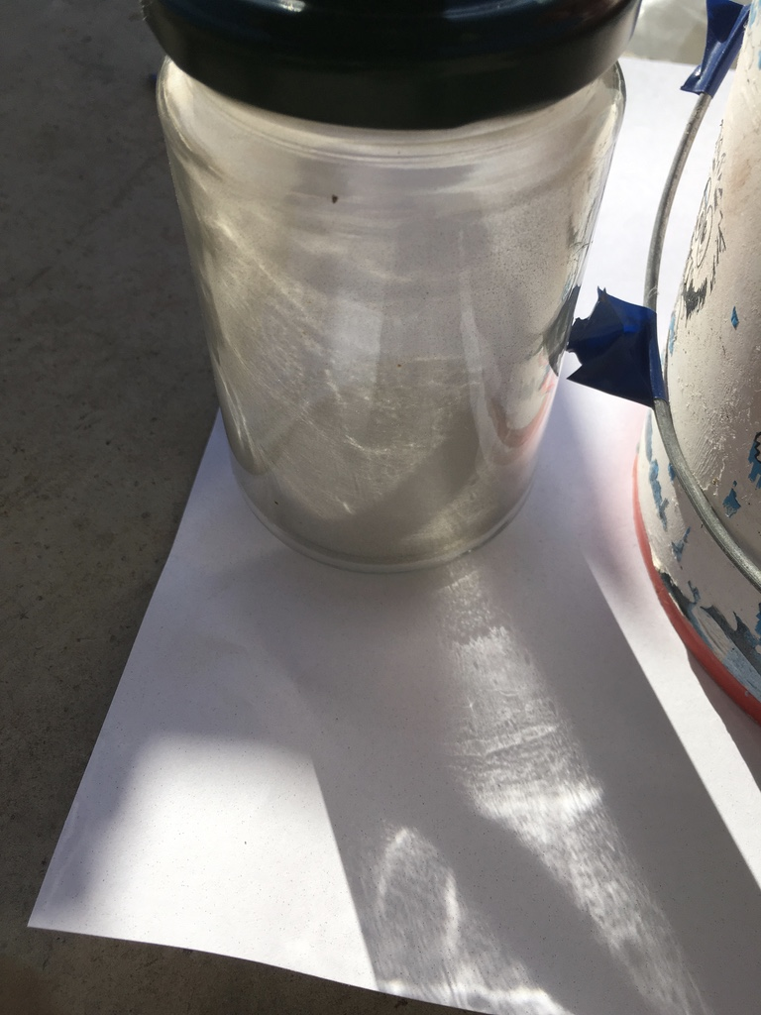
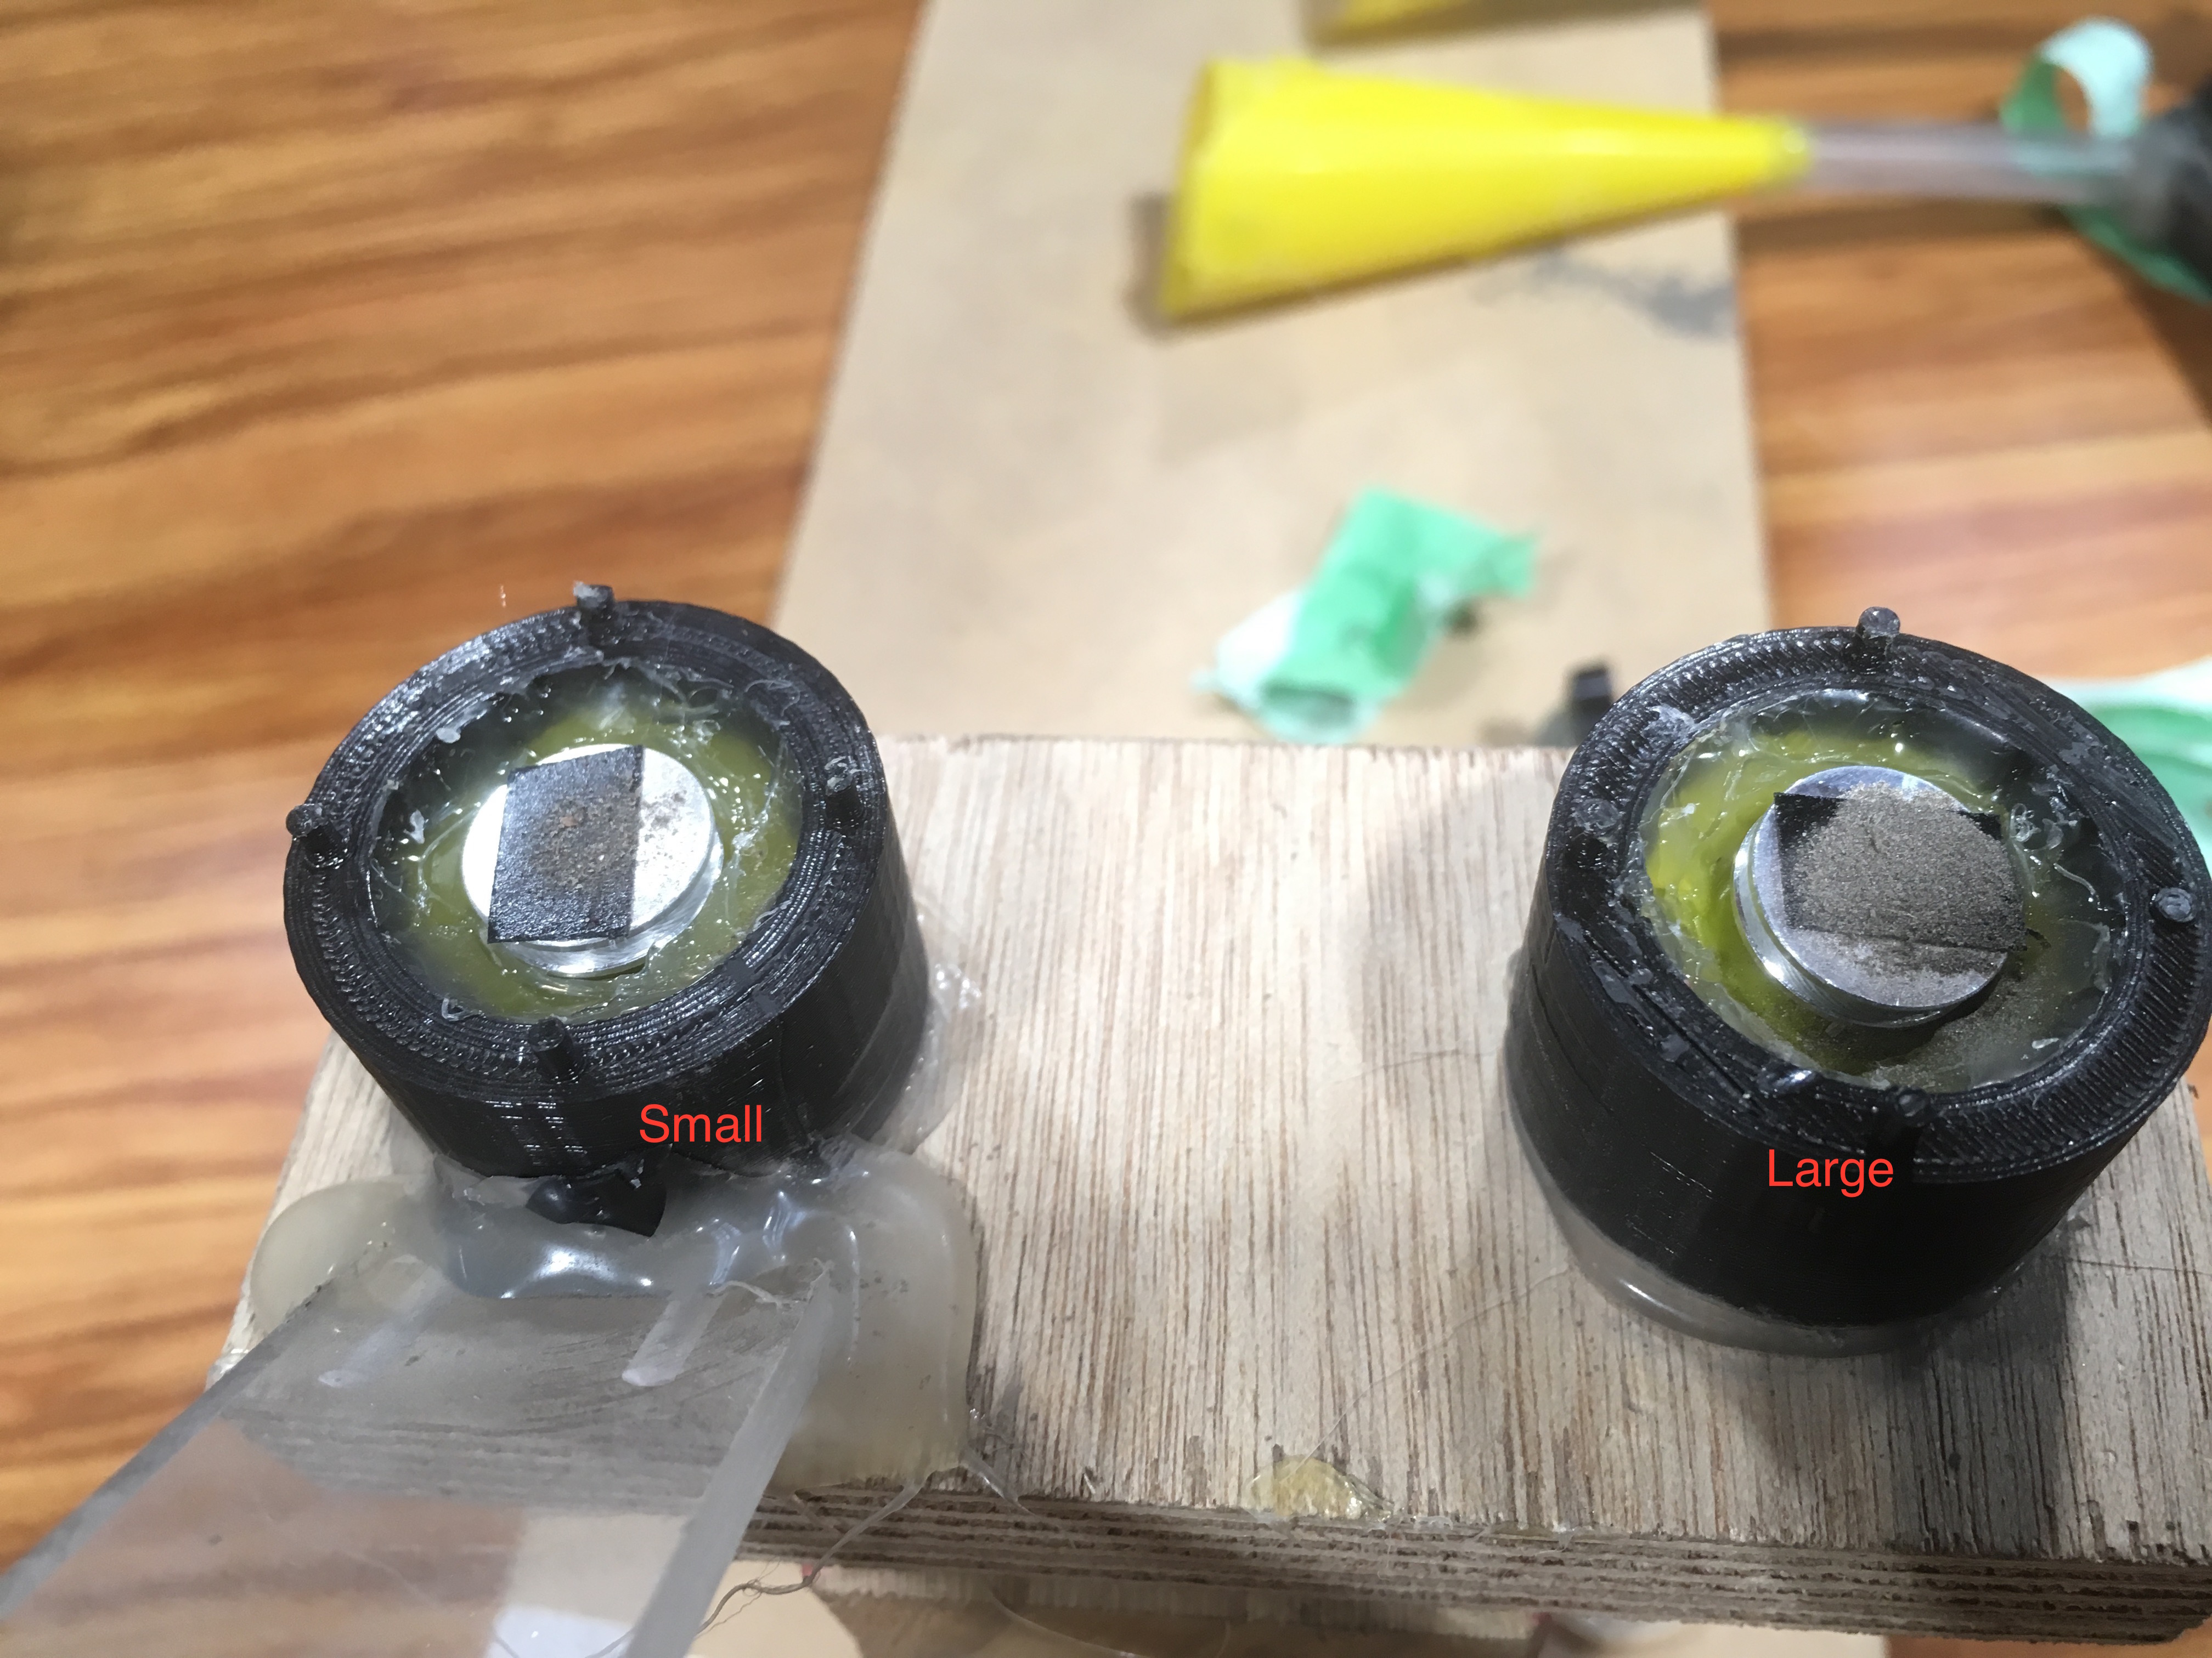
Physical Volcanic Ash Sampler
Frist design
Proof of concept
Second design
Testing cyclone size
Current Design
Rotary base for multiple samples
Before
After

Slide 4
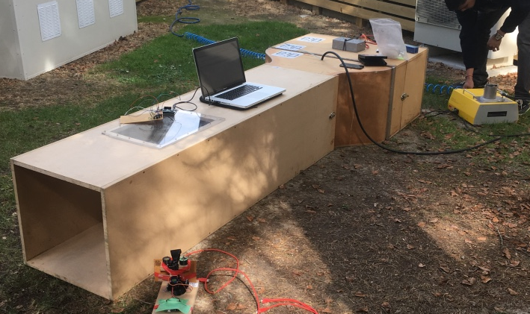
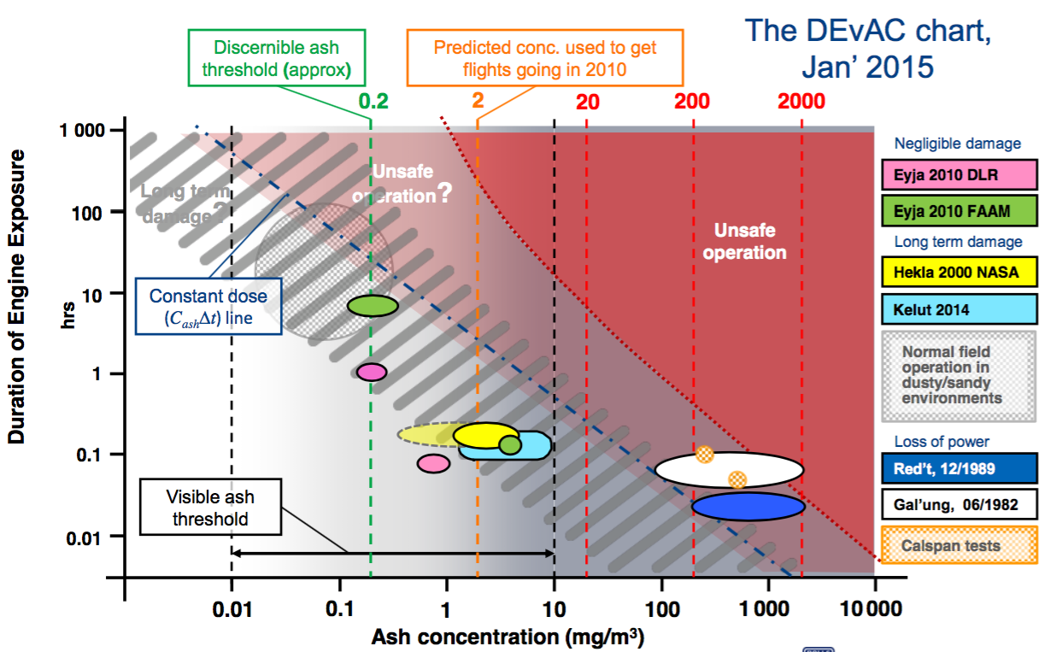
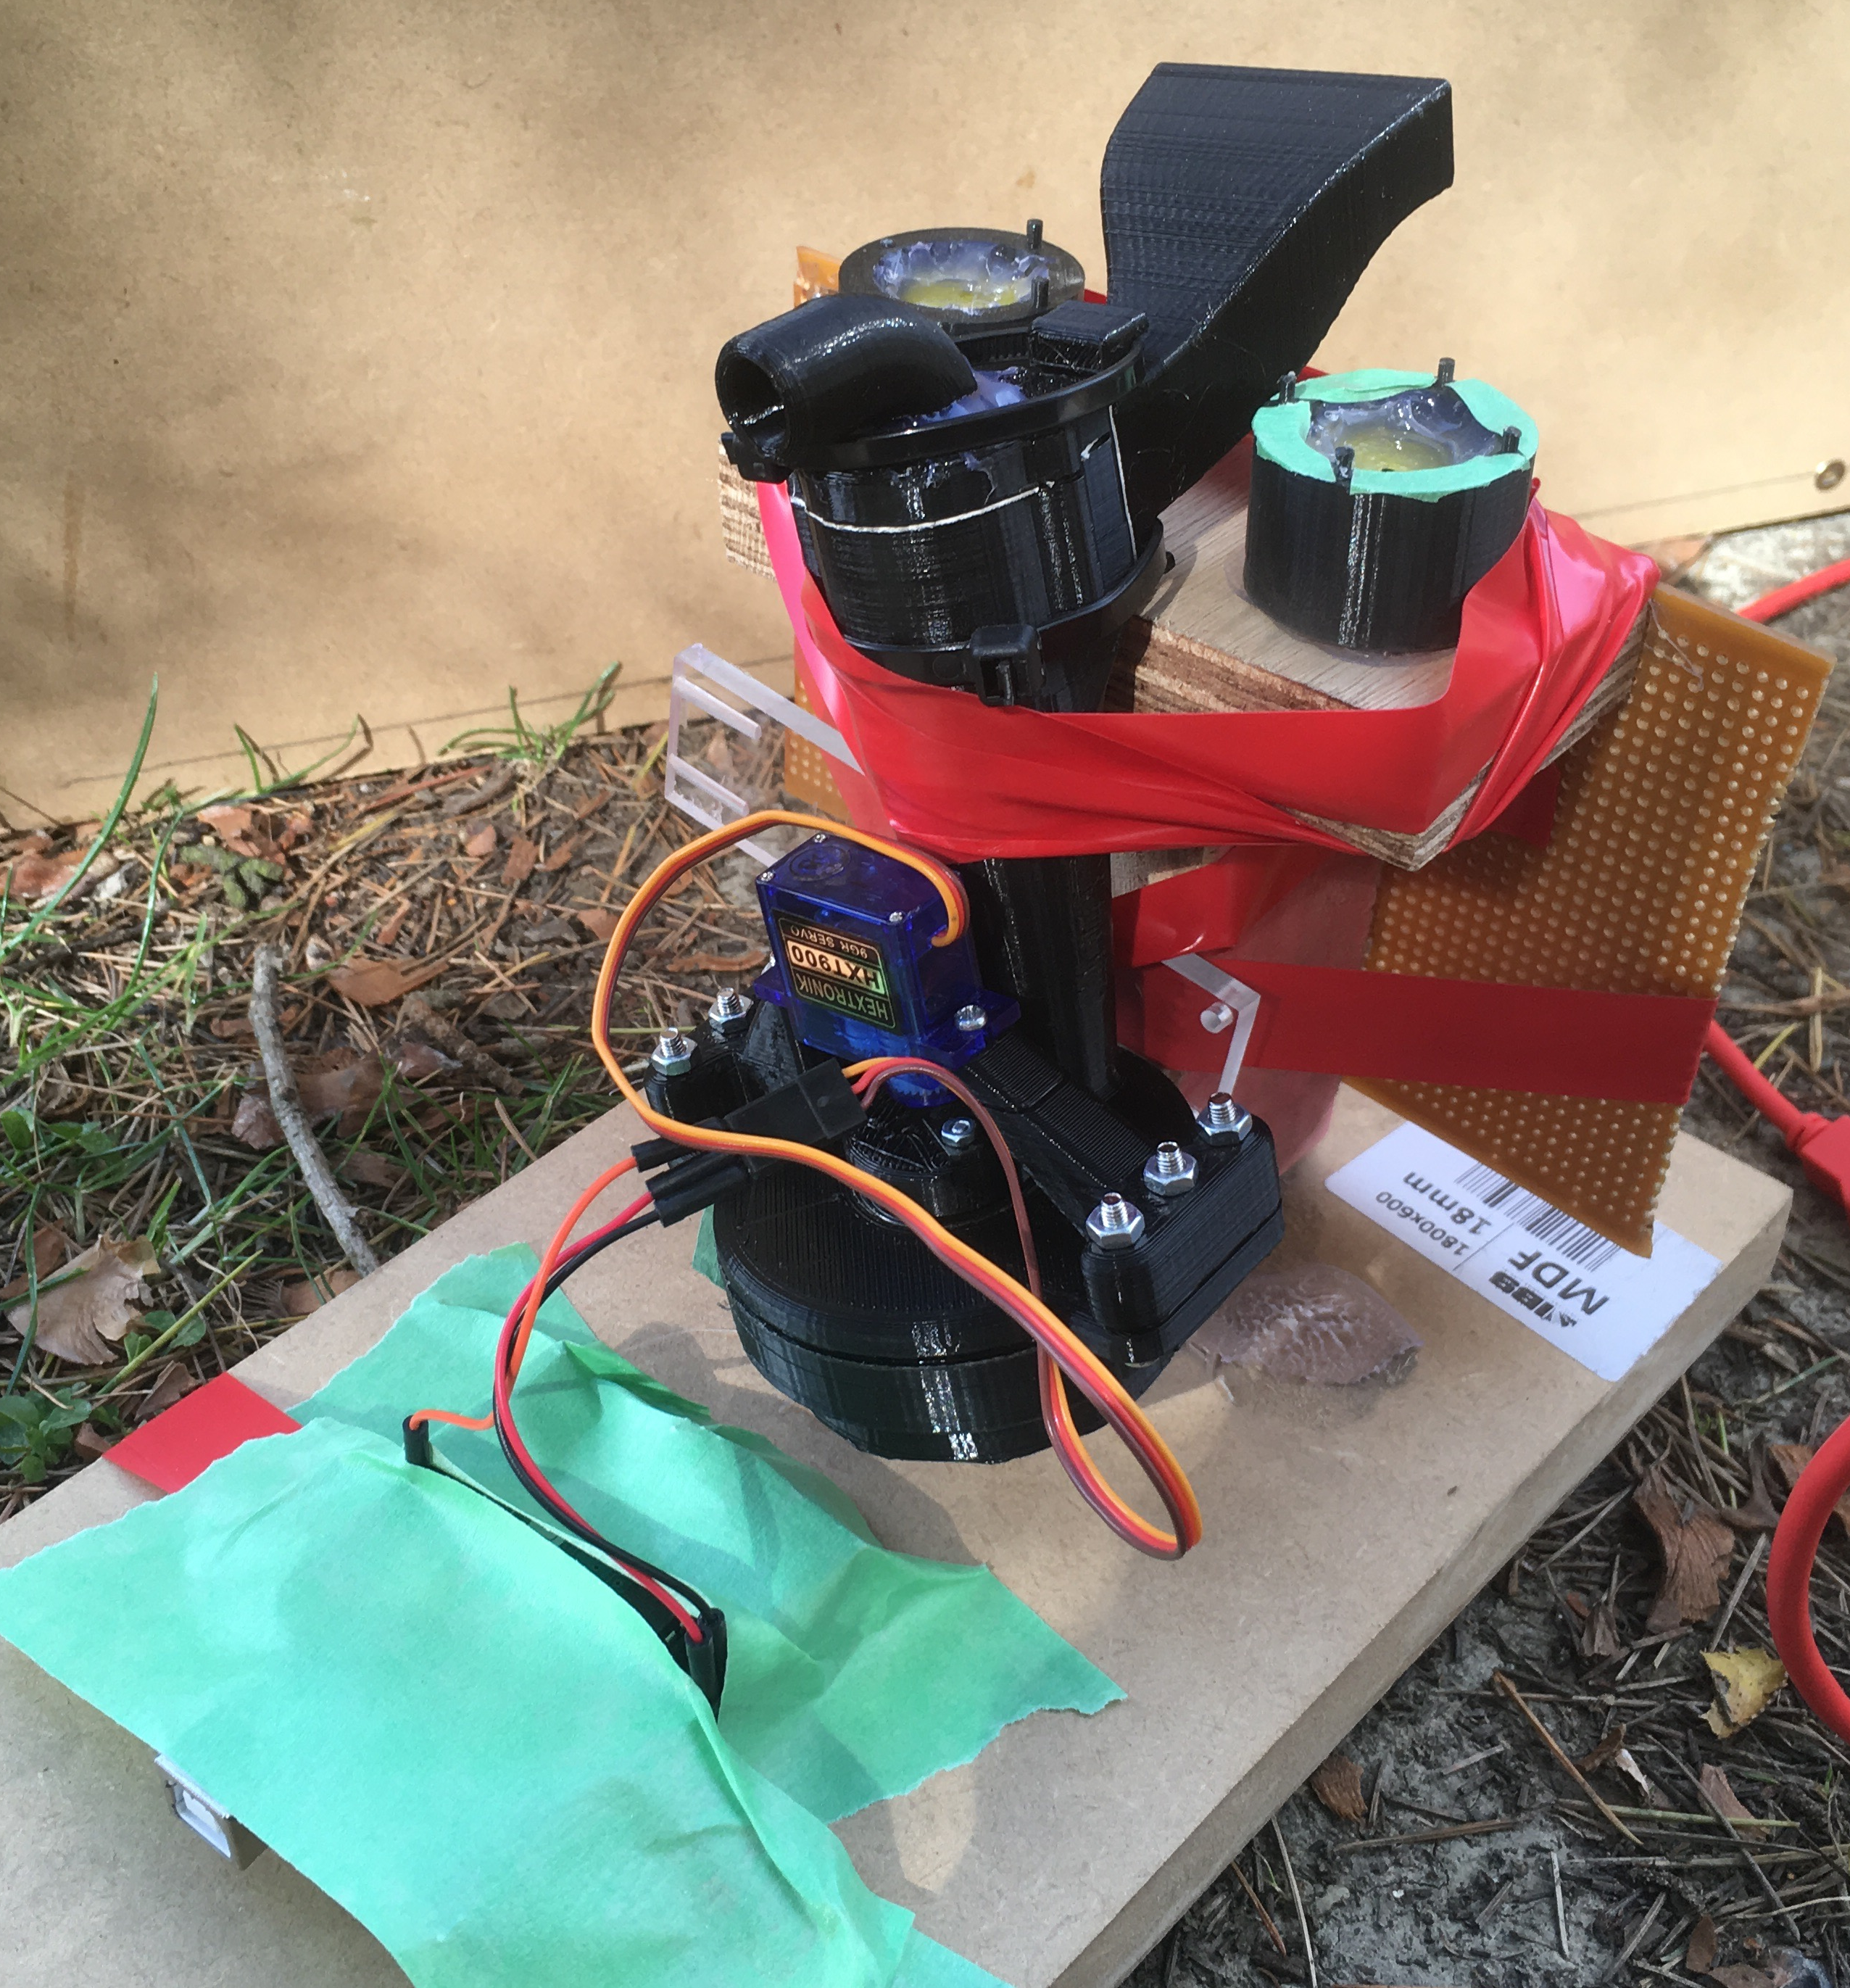
Testing cyclone in wind tunnel
Testing conditions needing to be met
Air speed of 5m/s
Ash density 10mg/m^3
Particle size < 50 micron
Temperature 20C to -20C
Air density of 1/3 of ground level air density
Solid aerosol generator (SAG)
Rotary cyclone prepared for testing

Slide 5
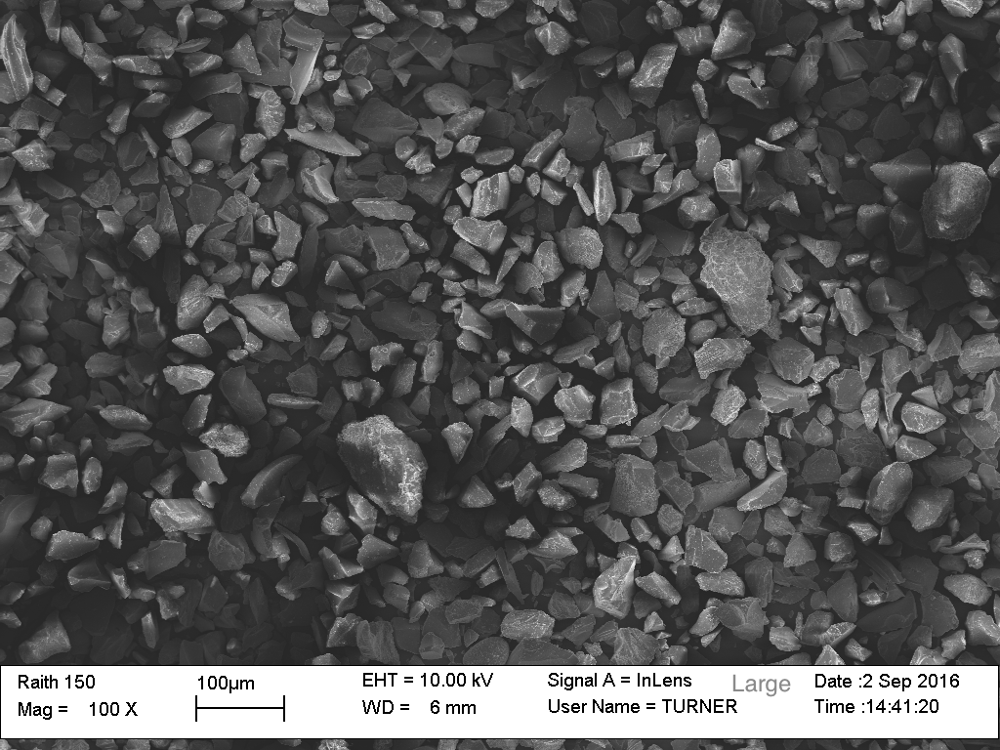
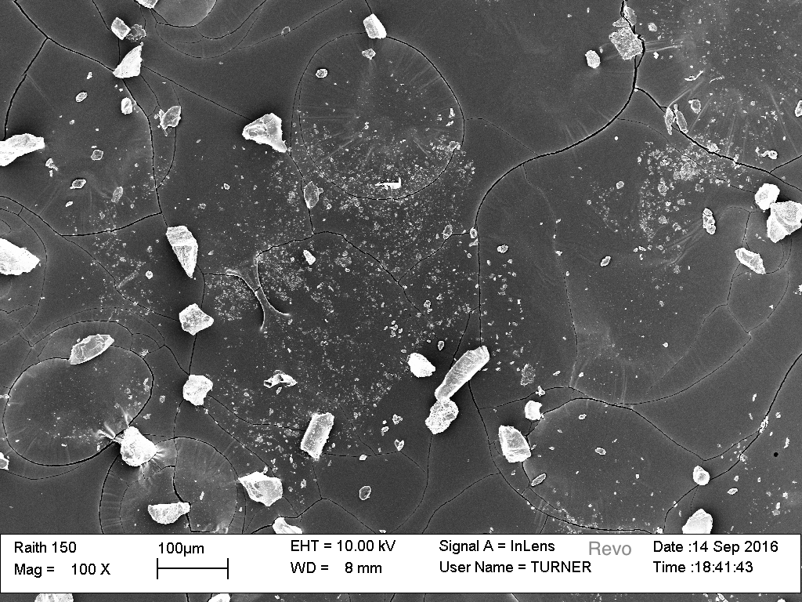
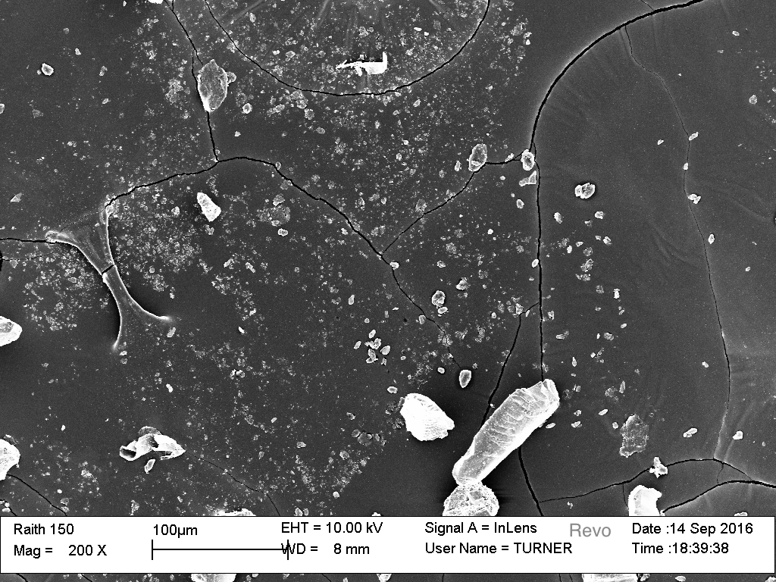
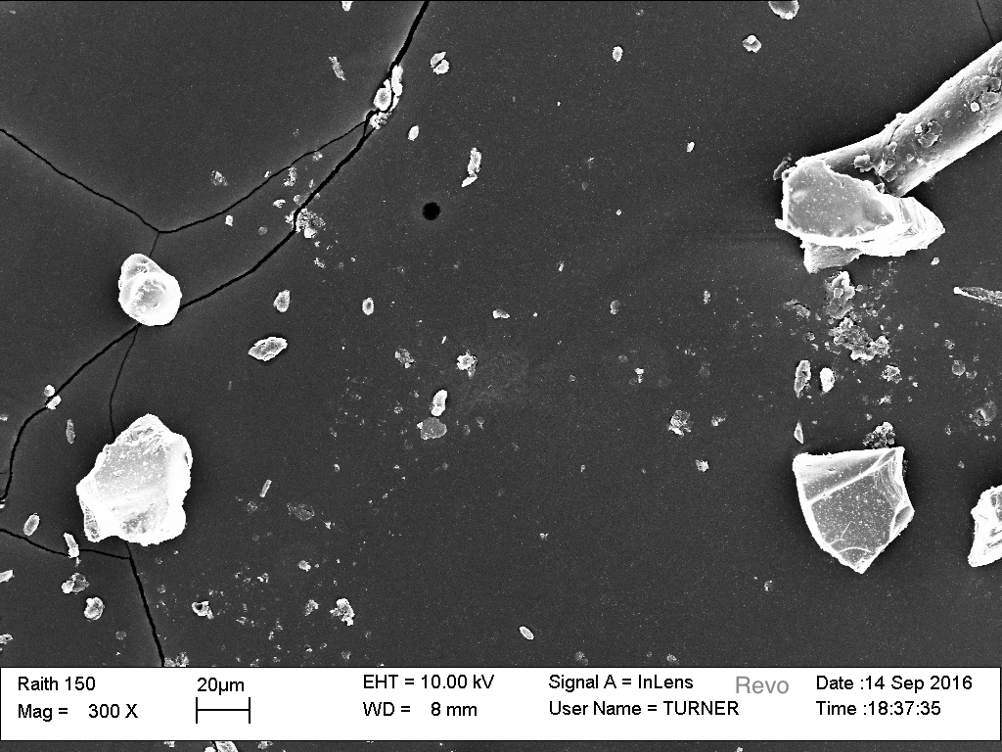
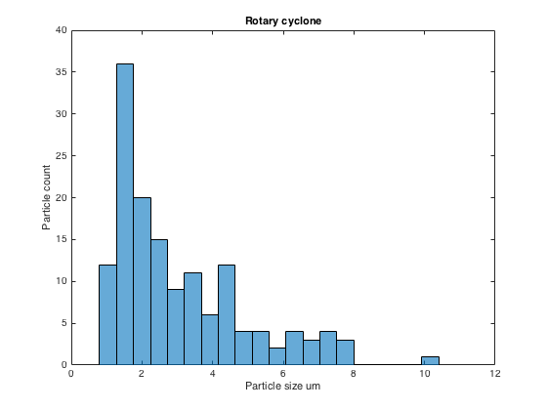
Results from scanning electron microscope
100X
200X
100X
300X
Particle distribution

Slide 6
Future design features
Smooth surfaces inside cyclone for less surface friction
Air tight bottom compartment
Less cambers for smaller size
Add 360 degree rotation from servo (currently only 180 degrees)
The ability to set the cyclone at any angle relative to the base

